Slide 1

Citycot Innovetion Hub

Slide 2

Boostrap

Slide 3
What is Bootstrap?
A free and open-source CSS framework.
A popular front-end framework for designing websites and web applications.

Slide 4

Your First Bootstrap Site
1
Set Up HTML
2
Use Bootstrap CDN
Create a basic HTML file
Add the stylesheet link from BootstrapCDN to your HTML file.

Slide 5
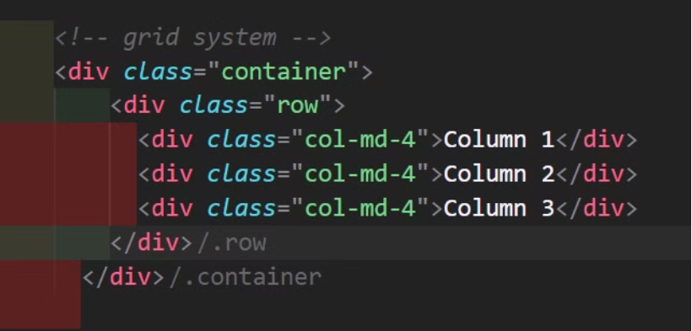
The Grid System
What is the Grid System?
A flexible 12-column grid system that allows you to create responsive layouts.
Bootstrap grid uses rows and columns.

Slide 6

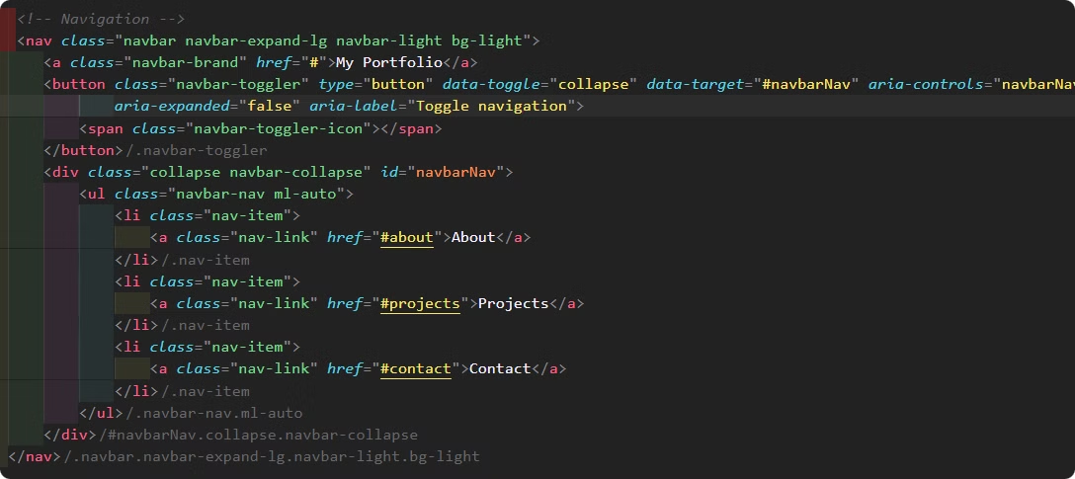
Navbars
navbar is a navigation component that allows users to navigate through different sections of a website.

Slide 7
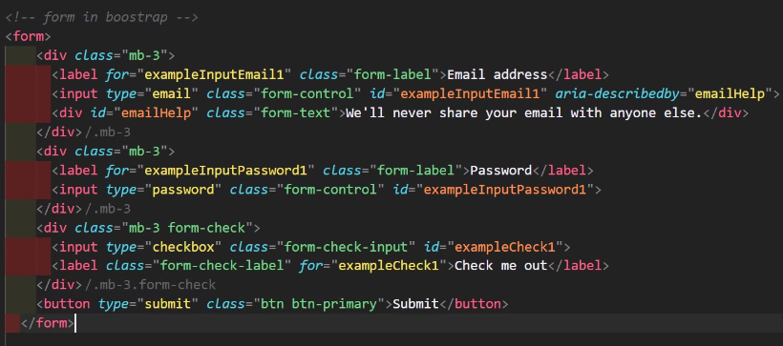
Form
Forms in Bootstrap are a set of responsive components that allow users to input data easily and efficiently.
Forms are typically structured using the .form-group class to group labels and input fields together.

Slide 8




Bootstrap Components
Buttons
1
Alerts
2
4
Modals
3
Cards

Slide 9
Scrollspy
is just good way of showing users where they are on the page at any point in time.

